Slide 1
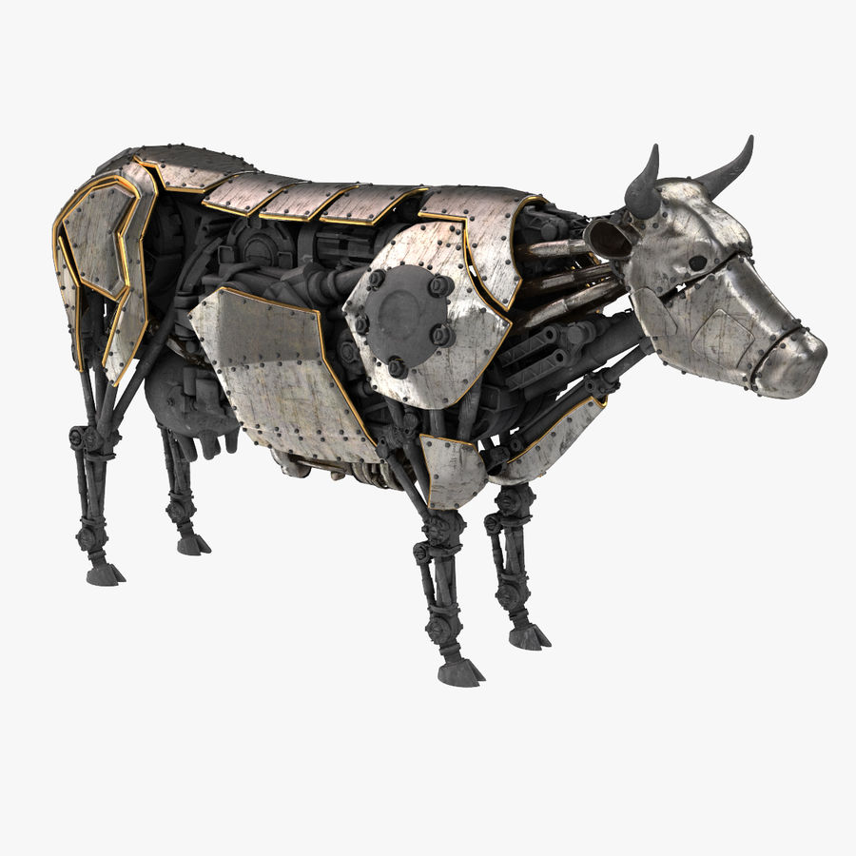


LyfeStock
GROUP 26

Slide 2
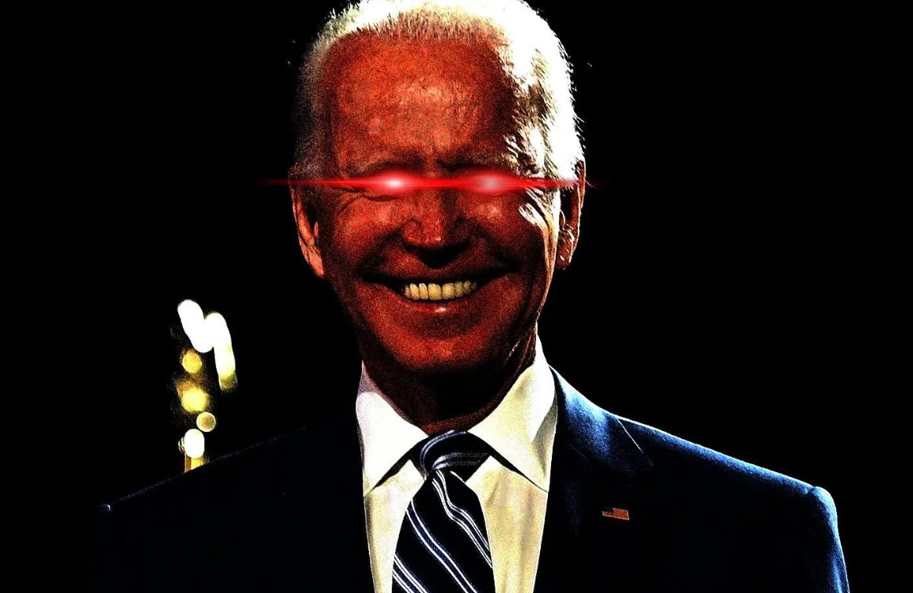
Harry Tan, Robert Malone,Youngsang Aum, Kenan Alghythee
In Collaboration With
Dark Biden Mode Has Been Activated

Slide 3
Project Description

Slide 4
Overview
Provides users with real-time data surrounding the health of their livestock.
Handles the ownership of the livestock and GPS tracking to provide a full service that ensures the overall well-being and management of livestock.
Uses modified Microchips implanted into livestock to collect biometrics about the animal, and processes it to provide useful metrics to the owner.
Rationale for [3]: the current microchips is only used for identification purposes.
Project Description
Notes:
Kenan

Slide 5
The Purpose of the Project
This project is for convenience of commercial and non-commercial livestock farmers. will provide farmers with the means to keep track of the overall health of their animals, detect fluctuations in their health in real-time before they could potentially spread to the entire herd. The target audience are interested in maintaining a healthy stock of animals to maximize their profits in meat and dairy markets.
Monitor the spread of infectious diseases among animals up-to-date to maximize the well-being of livestock and decrease the chances of any diseases spreading to humans as result.
Provide a higher quality of life to livestock
The businesses that would benefit from this application are any of the major meat-producing or dairy-producing companies such as Tyson Foods Inc, Hormel Foods Corp or Dairy Farmers of America Inc.
Purpose
Notes:
Kenan

Slide 6
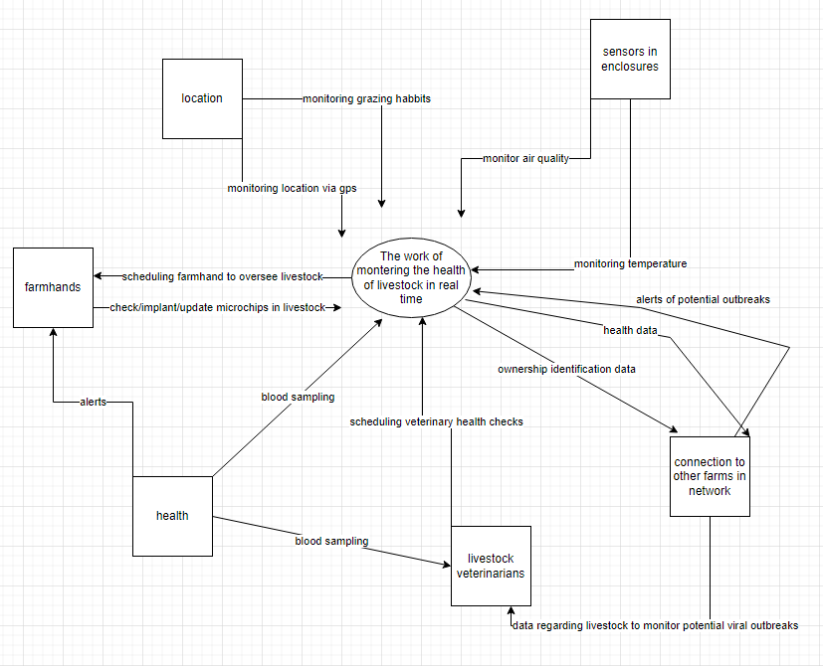
Scope of Work
Current situation → Farms are using technology that limits their ability to monitor the health of livestock and prevent the spread of diseases
LyfeStock → will bridge all these gaps by utilizing big data to provide live readings on possible health issues that animals might have to ensure the safety of products heading to market.

Slide 7
Scope of Product

Slide 8
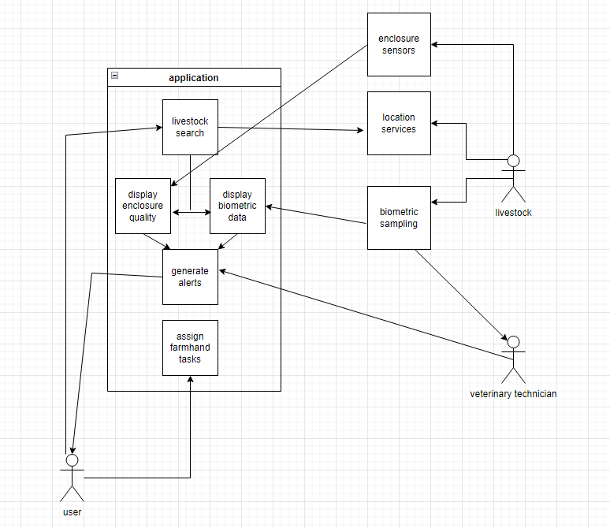
Scope of Project

Slide 9
Product Scenario - Preventative Health Check
Dale owns a small dairy farm that has been having issues with low production in recent weeks
In order to see if the health of his cows may be the reason, he checks the status menu of his farm
Noticing several yellow indicators on his cows’ data, he pulls up a biometric tab and sees that the issue has the early signs of udder infection in his cows, which is an expensive issue for most dairy farms
Having been alerted to the situation before it got out of hand, Dale manages to get his cattle on antibiotics to alleviate the issue
Scope of Product
Notes:
youngsang

Slide 10
StakeHolders
The company is the current client and is responsible for developing the application
The other organizations that might be involved:
Department of Health
Committee of Big Meat, Dairy, and Farming companies
Farmers Unions (regional / global)
Department of Food and Agriculture
Stakeholders
Notes:
youngsang

Slide 11
User Participation
Farmers are generally a demographic who are very hesitant to accept new technology
Extensive work with and feedback from the end users will be required to not alienate the target audience and make the product viable economically
Authorization from governing bodies (USDA) will be required to legally market the product to farms involved with providing food to civilians
Stakeholders
Notes:
youngsang

Slide 12
Constraints

Slide 13
Protect user privacy
Rationale
Biometric data collected is considered sensitive
Fit Criterion
All data is encrypted
All data is protected behind security measures
Constraints
Notes:
harry

Slide 14
Alert users quickly
Rationale
User must be able to quickly resolve any health issues
User must be aware of any sudden dangers to livestock
Fit Criterion
Application must have 80% uptime
Alerts must be generated within a 30 minute window of real-time dangers
Constraints
Notes:
harry

Slide 15
Provide accurate biometric information
Rationale
User is concerned with real-time health status
Danger to livestock well-being must be captured
Fit Criterion
Application must sample, package, and send biometric data to labs for analysis
Microchip is monitored with at least 80% uptime for any hardware failure
Constraints
Notes:
harry

Slide 16
Application is modularized
Rationale
User may not require all features of application to be active
Failure of one feature should not take down multiple features with it
Fit Criterion
All large subsystems in application do not have dependencies on each other.
Ex. heart rate subsystem does not depend on white blood cell count subsystem
There are multiple versions of the application, with different features → big farms version, small farms verison, big companies etc..
Constraints
Notes:
harry

Slide 17
Naming Conventions and Definitions
Report = 1 or more biometric readings
Biometric Reading = 1 reading related to 1 specific health area of livestock (i.e. hormone levels, cholesterol)
1- Alerts (For each animal):
Green(safe) → biometrics within acceptable parameters, no immediate action required
Yellow(decline) → biometrics indicate potential health issues, preventative actions/inspection recommended
Red (danger) → biometrics indicate animal is in critical condition, intervention required
Orange(malfunction) → one or more readings inconclusive or contradictory, manual inspection required
Notes:
youngsang

Slide 18
Facts & Assumptions
There are about 100 million cattle, 120 million hogs, 8 million sheep and goats, and 4 million horses in the United States
not counting livestock with high yearly turnover like poultry and fish
Chip implant costs around $50 per animal
Estimated annual cost of product loss due to animal disease/death: ⅓ of all distributed product based on current US market trends and animal mortality rates
compare to ⅙ annual mortality rate of domestic pets, who are chipped more regularly
Only 40% of livestock are chipped at the moment, mostly due to hesitancy over technology from farmers
Assumptions
all developers will be able to code in all mobile environments
US consumer diet won’t change drastically
US consumers care about the quality of their food
microchipping livestock remains a legal practice
cost to end user won’t outweigh the benefit of product
enough end users will adopt the product to make it viable into the future

Slide 19
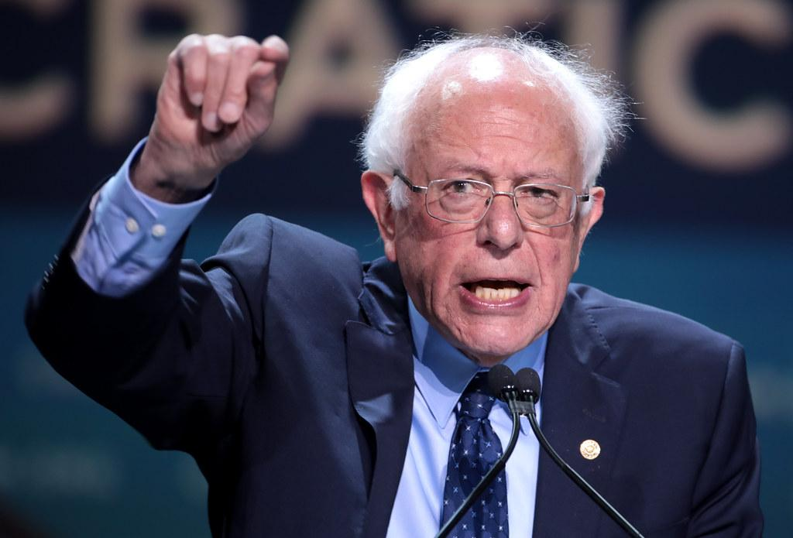
Hey Bell, this group should get 5/5

